Slide 1

SDSC3006 Fundamentals of machine learning project
NAME: Patra yuvraj SID: 55907774

Slide 2
BACKGROUND
DATASET
Evaluations of teaching performance over 3 Regular Semesters and 2 Summer Semesters
151 teaching assistant (TA) assignments at the Statistics Department of the University of Wisconsin-Madison
Score division into 3 approximately equal-sized categories
Low
Medium
High
These form the ‘Class variable’

Slide 3
BACKGROUND
ATTRIBUTE INFORMATION
1. Native English Speaker (Binary); 1: English speaker, 2: non-English speaker 2. Course instructor (Categorical) (25 categories) 3. Course (Categorical) (26 categories) 4. Summer/Regular Semester (Binary); 1: Summer, 2: Regular 5. Class Size (Numerical) 6. Class Attribute (Categorical); 1:Low, 2:Medium, 3:High

Slide 4
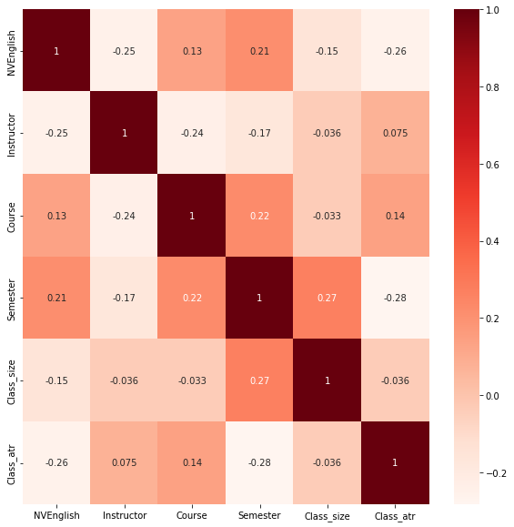
Data visualization
HEATMAP FOR DATA VISUALIZATION

Slide 5
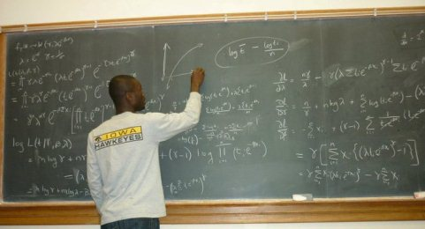
PROBLEM Statement
The objective of this project is to determine the best classification model that can classify the performance of the teaching assistant based on 5 attributes given in the dataset with high accuracy
Such results can be used to make decisions to improve the performance of TAs

Slide 6
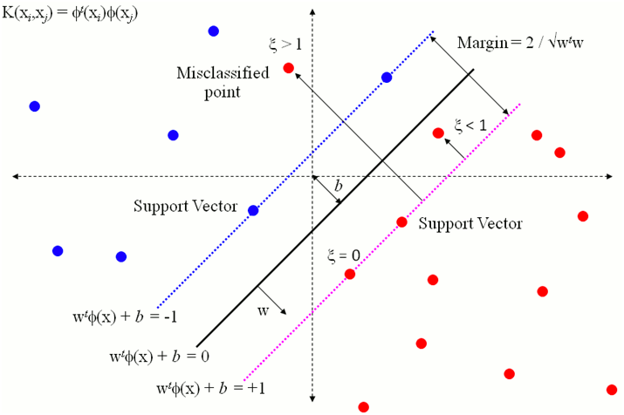
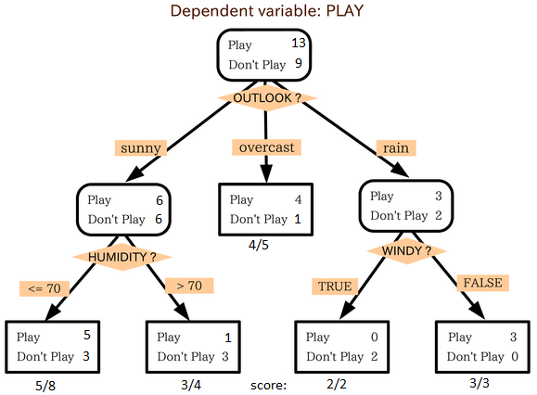
Strategy
The following classification models will be compared:
KNN (K Nearest Neighbours)
SVM (Support Vector Machines)
Decision Trees
The best classification model would determined after comparison based on multiple parameters such as:
Precision
Recall
F1-score

Slide 7
JUSTIFICATION
Since the dataset is highly categorical, it is a good idea to use a classification model that can categorize the performance of a teaching assistant efficiently with least scope of error
We have employed few of the most commonly used classification models for this purpose that can be conveniently implemented
Results of this project can help in decision making by predicting the performance of incoming TAs

Slide 8
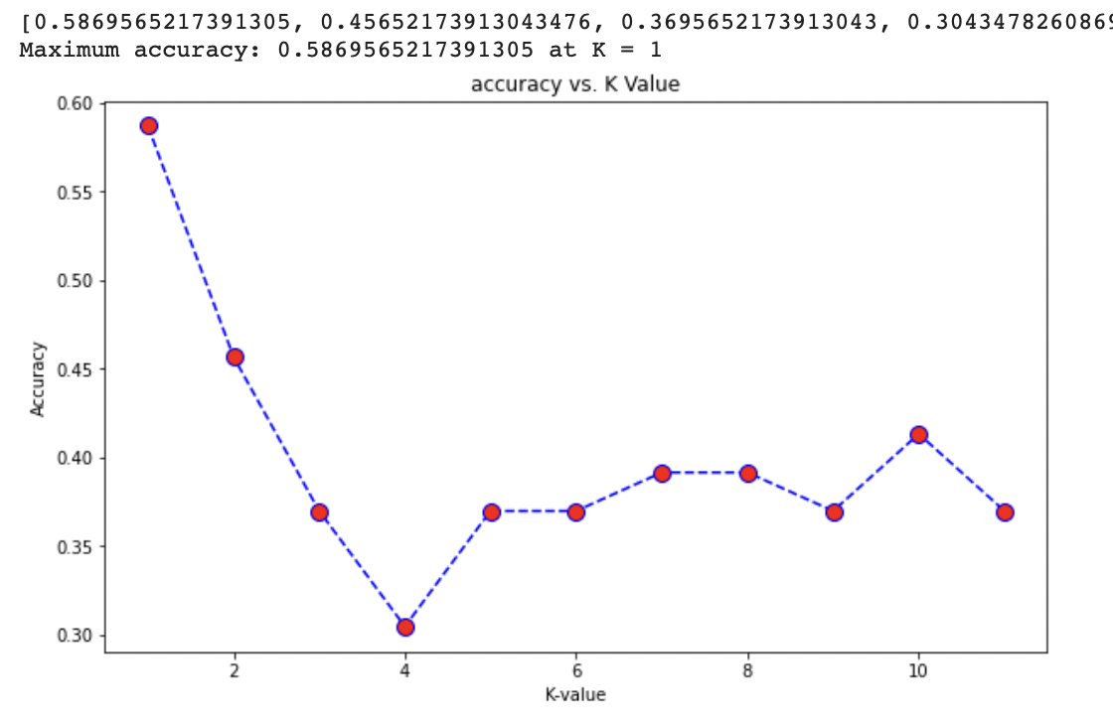
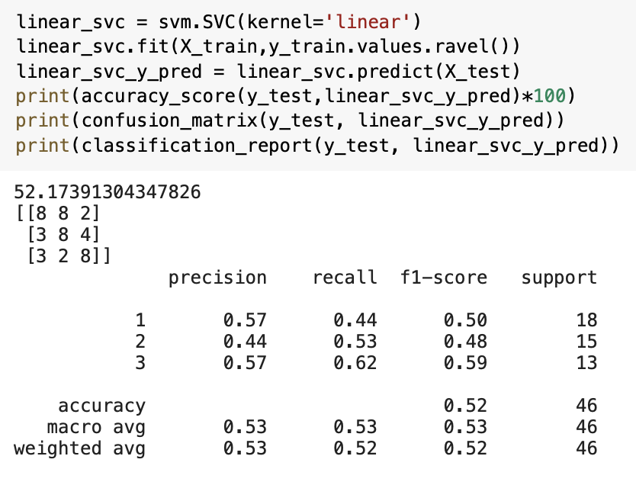
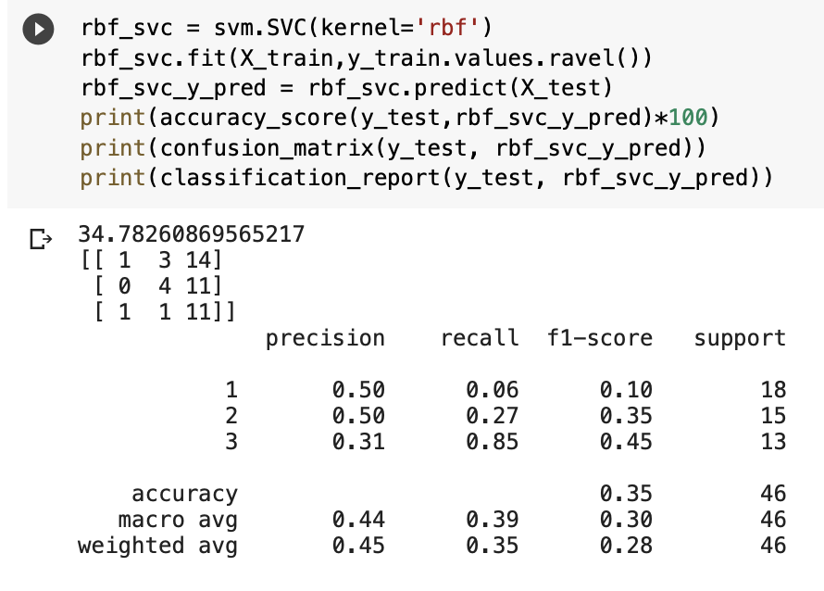
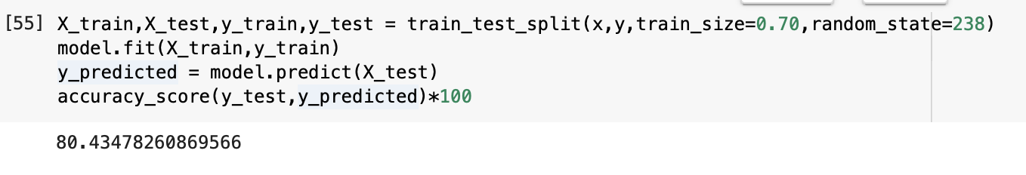
RESULTS
Accuracy
KNN ~ 39.9%
A) Linear SVM: ~52.17%
B) Radial SVM: ~34.78%
3. Decision Trees: ~80.43%

Slide 9
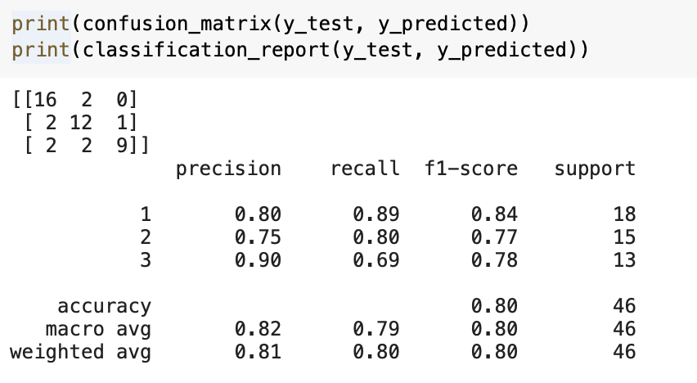
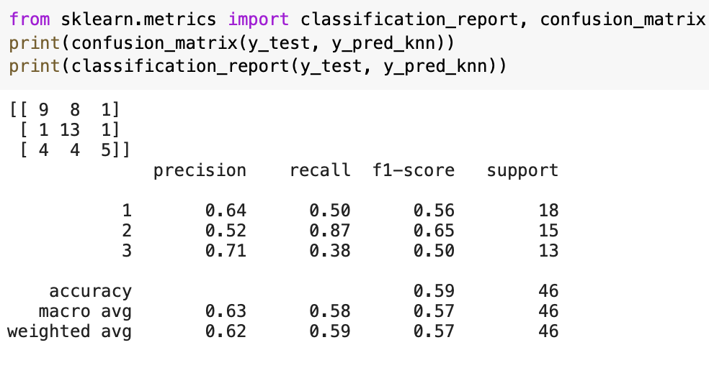
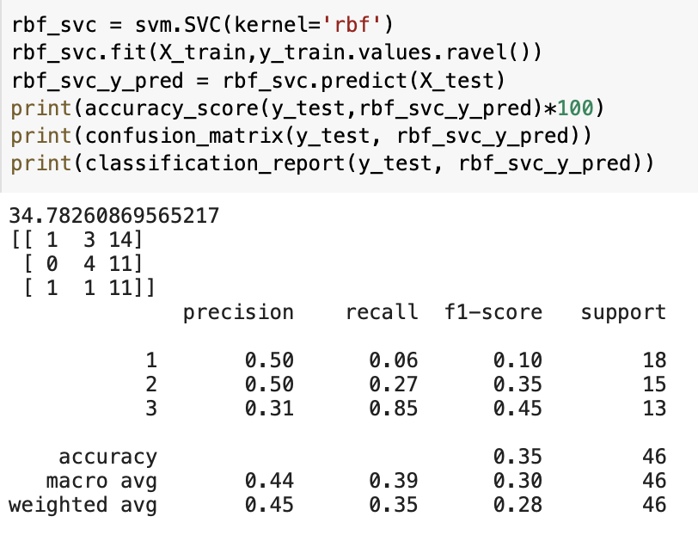
RESULTS
Precision
Recall
F1-score
DECISION TREE
Linear SVM
KNN
Radial SVM

Slide 10
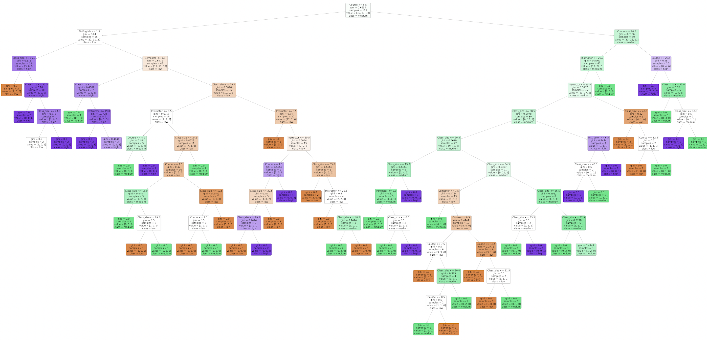
Decision Tree diagram

Slide 11
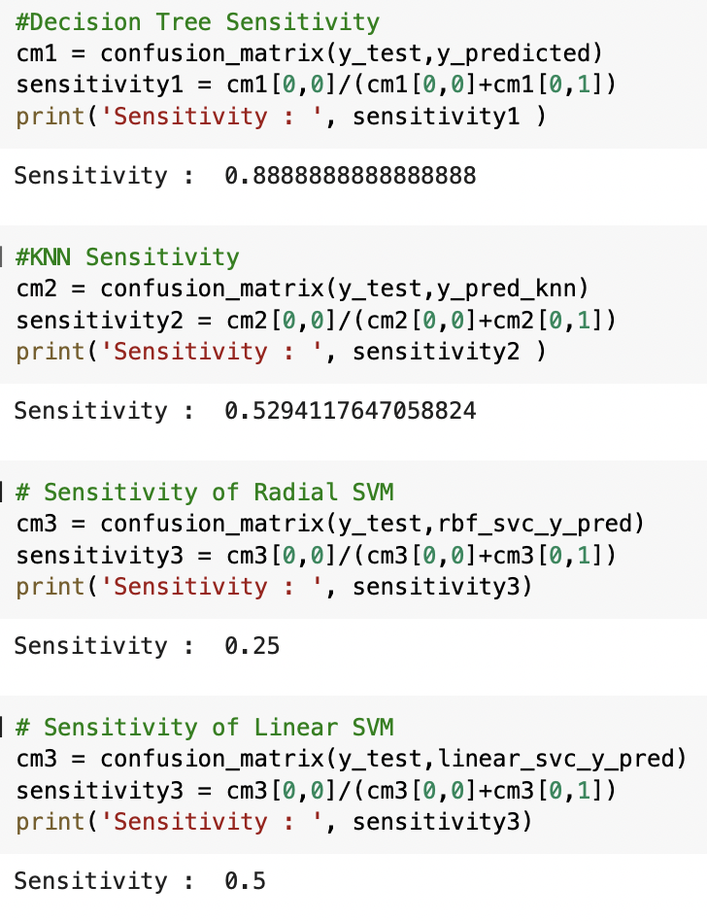
RESULTS
We observe that For Decision Tree: Overall Prediction Accuracy: 80.43% (high)
Precision of Class 1: 80%
Precision of Class 2: 75%
Precision of Class 3: 90%
Recall: Recall of Class 1: 89%
Recall of Class 2: 80%
Recall of Class 3: 69%
F1-score: Balance between Precision and Recall F1-score of Class 1: 84% F1-score of Class 1: 77% F1-score of Class 1: 78%

Slide 12
CONCLUSION
After our analysis we find that Decision Tree is the best classification model amongst the 3 implemented ones for the given dataset in order to predict the performance of a teaching assistant (TA)
This is because after testing the data using this model we obtain a high accuracy score, precision, recall, f1-score as well as the highest sensitivity for the Decision Tree Classification model
Discussion/CONCEPTS LEARNT
Data Visualization
Building Classification Models using Python
Comparing Different Supervised Machine Learning Methods based on multiple parameters

